Slide 1
Global AI Summit 2024, Hyderabad
MATHack 2.0
Automated Vehicle and Property Insurance
Team Name: Digital Eye
Members: Harsini A B - harsiniab22it@psnacet.edu.in
Harinee P - harineep22it@psnacet.edu.in
Dharun M - dharunm22it@psnacet.edu.in
DeepaLakshmi G - tharshnedeepa2004@gmail.com
Hariharan E - hariharane22it@psnacet.edu.in
Date: 04.09.2024 & 05.09.2024

Slide 2
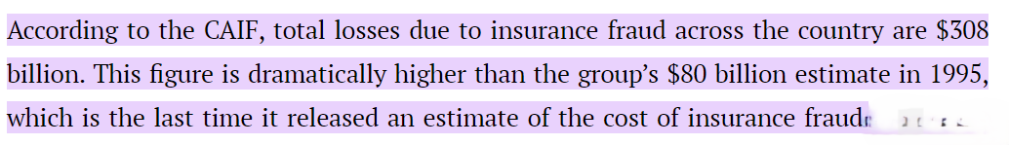

Problem Statement
To automate the manual, time consuming property and motor insurance claiming process
Susceptibility to fraudulent claims

Slide 3

Existing Approaches
Manual inspections:
Charted Engineer’s onsite visit
Time Consuming and subjective
Stakeholders:
Policy providers
Policy holders

Slide 4
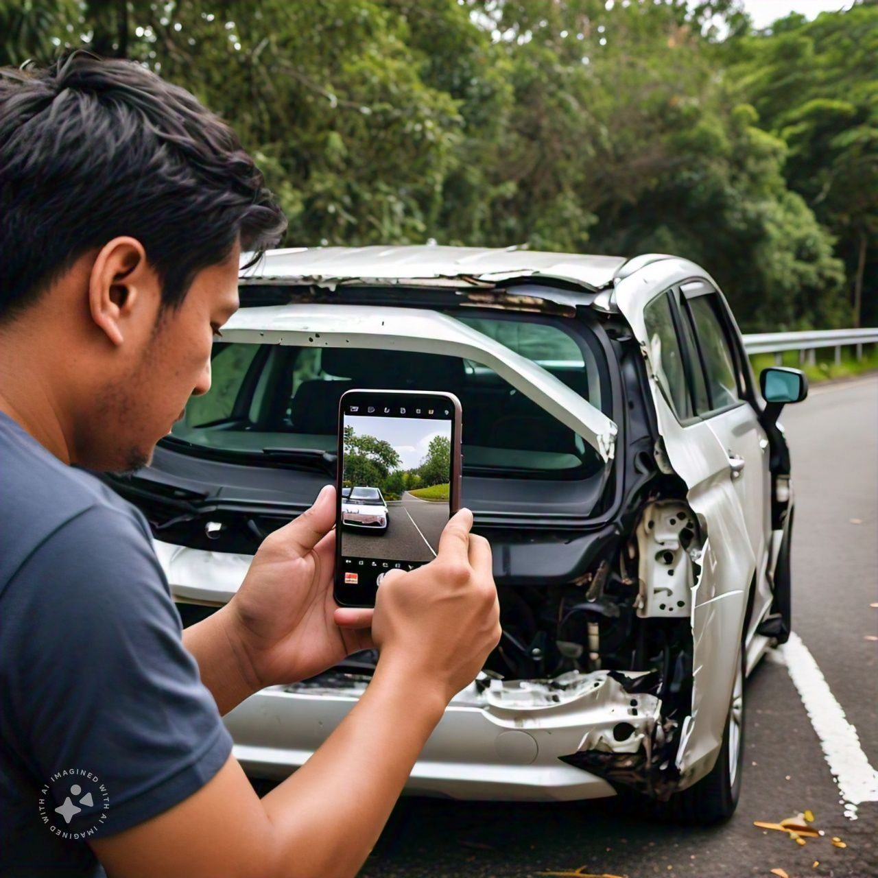
Proposed Solution
AI-powered claim process Automation
On cam fraud detection
Trust assessment using NLP
Damage assessment
Cost Estimation

Slide 5
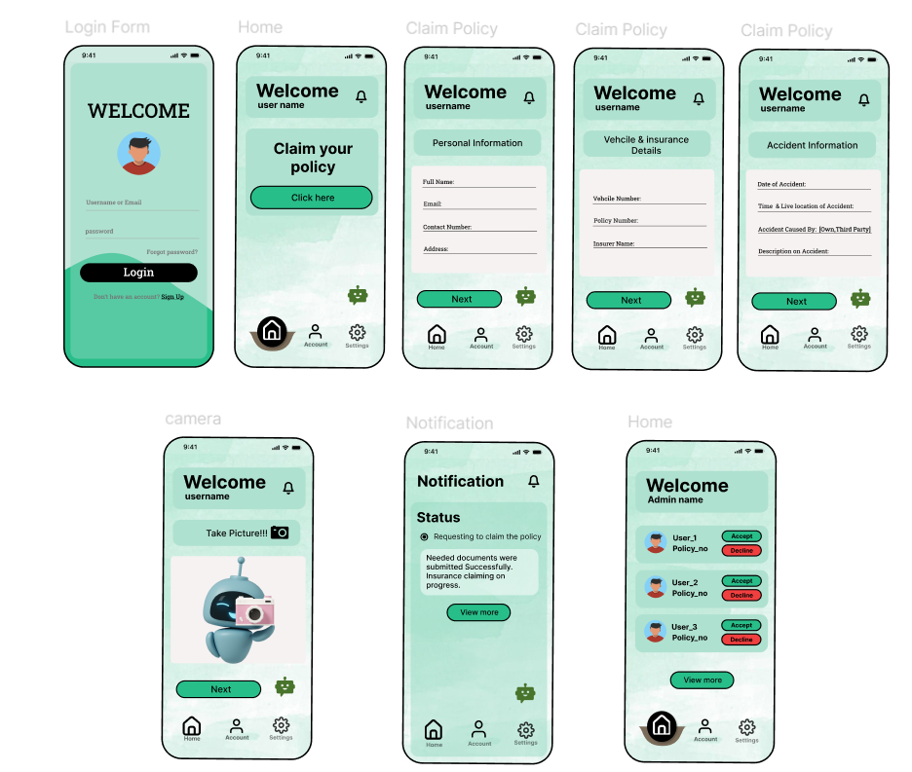

Slide 6
Unique Selling Point (USP):
Fraud detection and trust assessment:
Correlating the keywords from the user provided description and the actual damage that is visible in the image
Police document verification using LLM to correlate the accident description by the police and the user if any third party interfere

Slide 7
Flow Diagram
Capture Images
AI
(CNN) + NLP
Detailed Description
Police Description(FIR)
Policy Provider
User
Yes
Fraud Detection
No
Notification
Damage Severity & Cost Assessment
Claim Approval

Slide 8
Advantages
Tech Architecture
Speed and accuracy
Cost reduction
Improved customer experience
Fraud prevention
Components:
Computer vision models (CNNs)
NLP
Workflow automation
Integration:
User-friendly interface for image capture
External databases for cost refinement

